Slide 1

Latinas in Leadership
Assessments and Impact
Dr. Chris Cavanaugh
November 13, 2021

Slide 2
Purpose
The purpose of this workshop is to set aside the day-to-day challenges to think strategically about my personal leadership skills, talents, and abilities; identify how I can best leverage my strengths; and become more self-aware of areas for improvement as I consider leading within the theological higher education space as a
Latina in Leadership.

Slide 3
Today’s Agenda
The “Rose” Introductions
Understanding more about MBTI Types
Group Exercises
Thoughts on the Hogan Insights
Yes and…
Strategies for Success
Reflection Questions

Slide 4
Understanding the Sixteen Types
Extraversion (E)
Oriented to the outer world
Focusing on people & things
Active
Using trial & error with confidence
Scanning the environment for stimulation
Introversion (I)
Oriented to the inner world
Focusing on ideas, inner impressions
Reflective
Considering deeply before acting
Finding stimulation inwardly

Slide 5
Understanding the Sixteen Types
Sensing Perception (S)
Perceiving with the five senses
Attending to practical and factual details
In touch with the physical realities
Attending to the present moment
Confining attention to what is said and done
Seeing “little things” in everyday life
Attending to step-by-step experience
Letting “the eyes tell the mind”
Intuitive Perception (N)
Perceiving with memory and associations
Seeing patterns and meaning
Seeing possibilities
Projecting possibilities for the future
Imagining; “reading between the lines”
Looking for the big picture
Having hunches; “ideas out of nowhere
Letting “the mind tell the eyes”

Slide 6
Understanding the Sixteen Types
Thinking Judgment (T)
Using logical analysis
Using objective and interpersonal criteria
Drawing cause and effect relationships
Being firm-minded
Appreciates logical order
Being skeptical
Feeling Judgment (F)
Applying personal priorities
Weighing human values & motives, my own and others
Appreciating
Valuing warmth in relationships
Appreciates harmony; trusting

Slide 7
Understanding the Sixteen Types
Judging (J)
Using thinking or feeling judgment outwardly
Deciding and planning
Controlling and regulating
Goal oriented
Wanting closure, even when data are incomplete
Perceiving (P)
Using sensing or intuitive perception outwardly
Taking in information
Adapting and changing
Curious and interested
Open-minded
Resisting closure to obtain more data

Slide 8
Which Do You Prefer?
Implications for Action
Interpersonal Response
    Some People Prefer To: Others Prefer to:
    TALK IT OUT THINK IT THROUGH
Focus of Information
    Some People Prefer: Others Prefer:
    SPECIFICS THE BIG PICTURE
Reason for Action
    Some People Prefer: Others Prefer:
    LOGICAL IMPLICATIONS IMPACT ON PEOPLE
Approach to Problem Solving
    Some People Prefer: Others Prefer:
    JOY OF CLOSURE JOY OF PROCESS

Slide 9
Small Group Exercise
Group 1 (ST): Nora, Wendy
Group 2 (SF): NONE
Group 3 (NF): Melissa, Ahida, Loida, Doris,
Maria, Teresa, Joanne W., Becky, Soco
Group 4 (NT): Jackie, Joanne R., Xochitl, Ruth-Aimee
  Discuss the following questions
  What do I want to be appreciated for?
  What irritates me on-the-job?
  What do I do that most annoys others?
  What might be some blind spots?

Slide 10
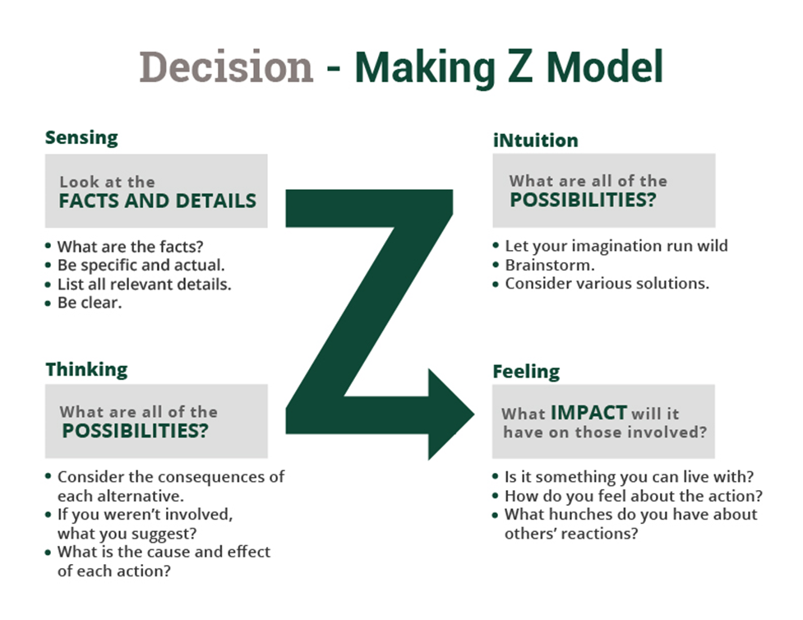
Decision Making/Problem Solving

Slide 11
Human Type Table (HTI-LIL)
ISTJ Nora, Wendy | ISFJ | INFJ Melissa, Ahida, Maria | INTJ
ISTP | ISFP | INFP Loida, Becky | INTP Jackie, Joanne R.
ESTP | ESFP | ENFP Soco | ENTP
ESTJ | ESFJ | ENFJ Doris, Joanne W., Teresa, | ENTJ Xochilt, Ruth-Aimee

Slide 12
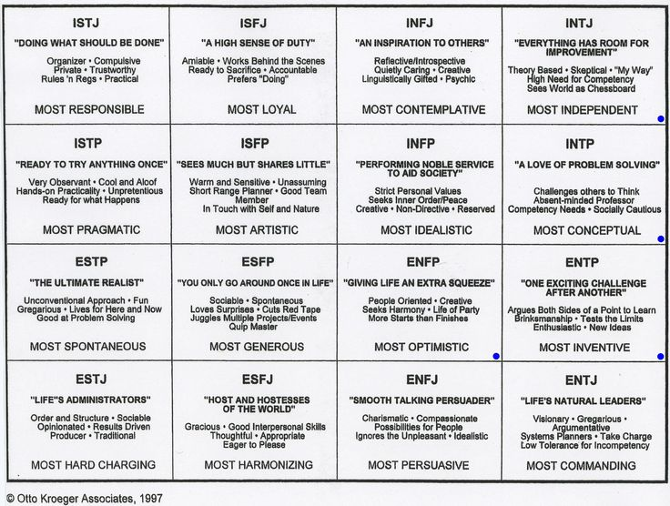

Slide 13

Hogan Assessment -- Insights

Slide 14
Hogan Overview
Intrapersonal Skills – Intrapersonal skills develop early in childhood and have important consequences for career development in adulthood, which include core-self esteem, resiliency, and self-control, and form the foundation on which careers develop.
Interpersonal Skills - Interpersonal skills concern building and sustaining relationships and can be described in terms of an ability to (a) put oneself in the position of another person, (b) accurately perceive and anticipate other’s expectations, and (c) incorporate information about the other person’s expectations into subsequent behavior.
Business Skills - Business skills differ from Intrapersonal and Interpersonal skills in that they are (a) the last to develop, (b) the easiest to teach, (c) the most cognitive, and (d) the least dependent upon dealing with other people. Business skills involve comparing, compiling, innovating, computing, analyzing, coordinating, synthesizing, and so on.
Leadership Skills - Leadership skills depend upon successful development of intrapersonal, interpersonal, and technical skills. Leadership skills entail an ability to (a) recruit talented people, (b) retain talent once it has been recruited, (c) motivate subordinates, (d) develop and promote a vision for the team, and (e) involves being persistent and hard to discourage.

Slide 15
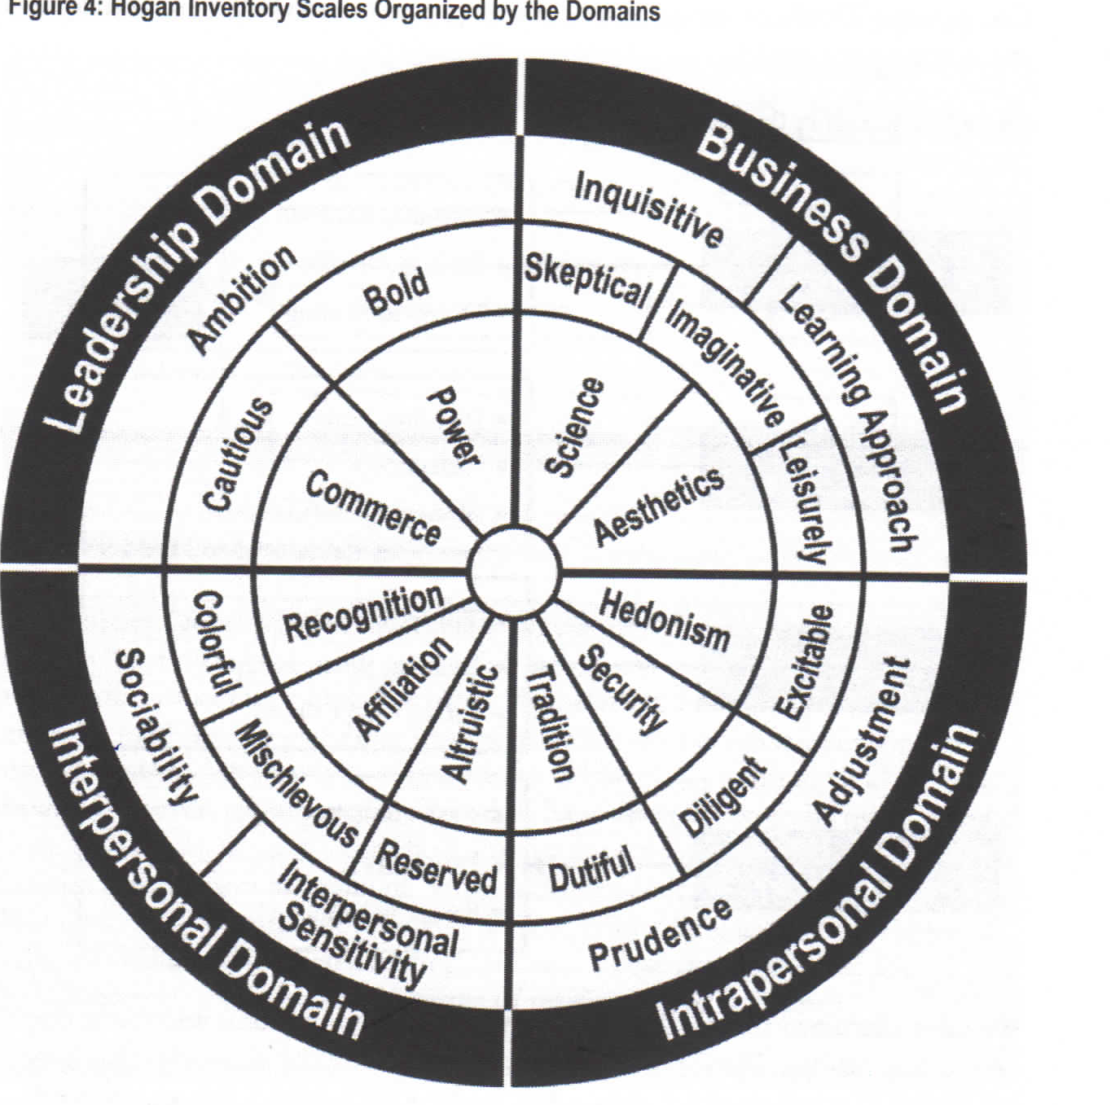
Domains
Notes:
Adding notes –

Slide 16
Yes And…..
What are some of the
gifts and talents that I
bring as a leader?

Slide 17
Yes And…..
What are some of the ways
that I hold myself back?

Slide 18
Yes And…..
How do I want
to show up as a leader?

Slide 19

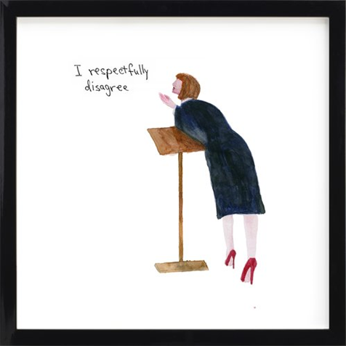

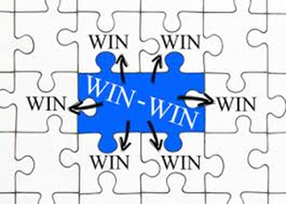
Leadership Strategies

Slide 20
Reflection Questions
What are the strengths that I can offer?
What are the areas that I want to concentrate on during this Leadership Training?
What are the expectations/assumptions that I hold for myself as I consider new opportunities in a leadership role?
How do I best leverage my gifts and talents to create impact and achieve my personal and professional goals?

Slide 21
Setting an Intention
What is the one word or phase that you
want to set as your personal intention as
a result of this HTI-LIL meeting?

Slide 22
Muchas Gracias!
Further Questions?
Please contact me at:
Dr. Chris Cavanaugh
pathseekers2@yahoo.com
919-338-3795

